Slide 1

Moving Past A Global Pandemic
Aneesh Kapoor
Data 606 Capstone Project
Spring 2021

Slide 2
Phase 3
Model Preparation and Execution
Model Interpretation
Conclusions
Future Research

Slide 3
Adjusted Vaccination Rates
Decrease Vaccinations by 20% for Asian and White Demographics
Increase Vaccinations by 20% for Hispanic and African American Demogrpahics

Slide 4
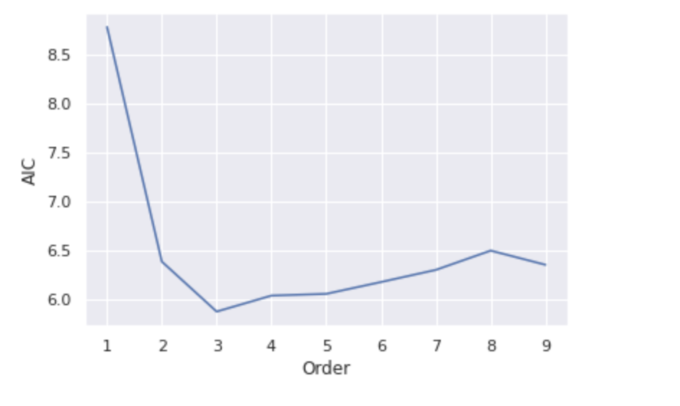
Vector autoregression (VAR) Model
A VAR Model is an autoregressive model that uses a linear function with lagged values to learn the relationship between multiple variables.
When using a VAR model, the user must select the optimal number of Lags. For this dataset, 3 Lags was the optimal because it had the lowest AIC value.

Slide 5
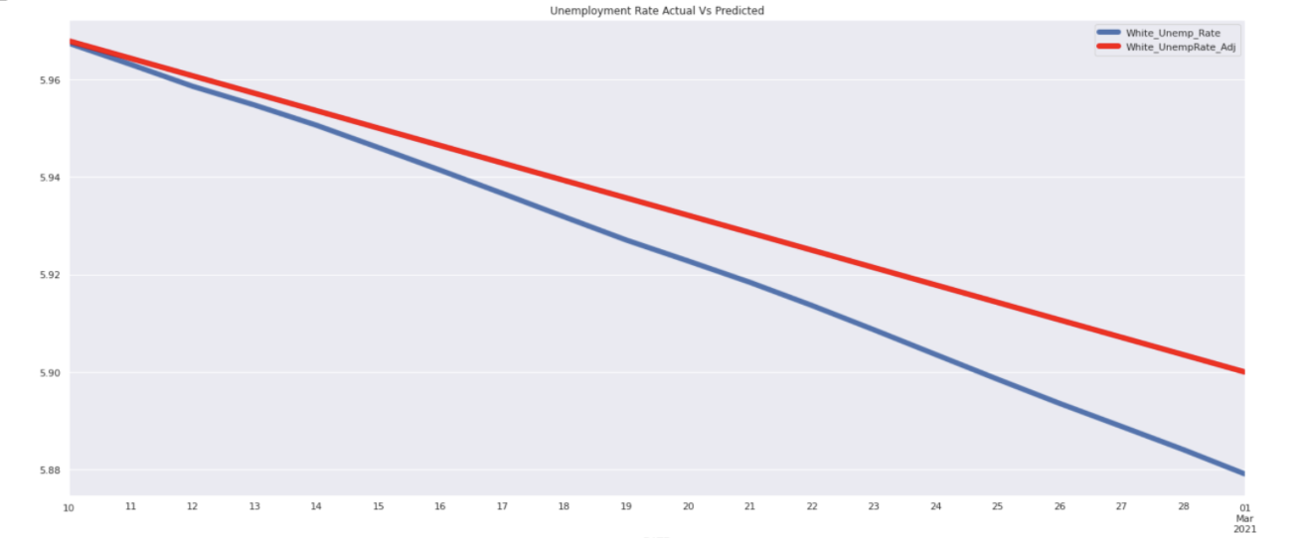
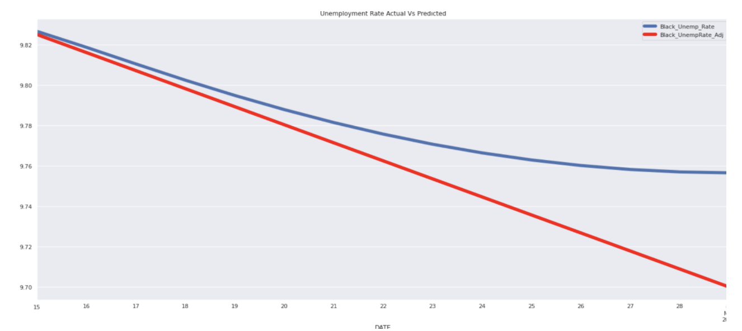
Vector autoregression (VAR) Model - Unemployment

Slide 6
Vector autoregression (VAR) Model
Small decline in unemployment and small increase in consumption for minority demographics.
Small increase in unemployment and decrease in consumption for White and Asian groups.
Based on the Mean Absolute Percentage Error the level of accuracy was 81% for this model.

Slide 7
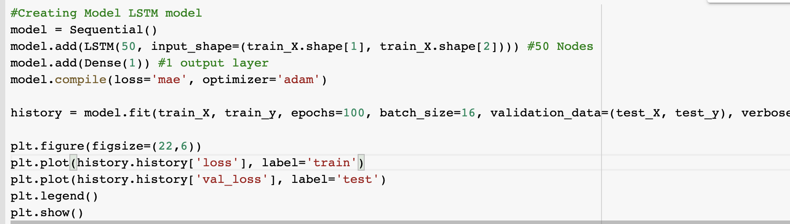
Long short-term memory (LSTM) Model
An LSTM model is a type of Recurrent Neural Network. Where as standard RNN will only consider inputs in the short term, an LSTM model will preserve inputs over the long term. This has proven to be very effective for Time Series datasets.
This model consists of two layers. After adjusting the parameters the results indicated a high level of accuracy. The following plots are the results of this model.

Slide 8
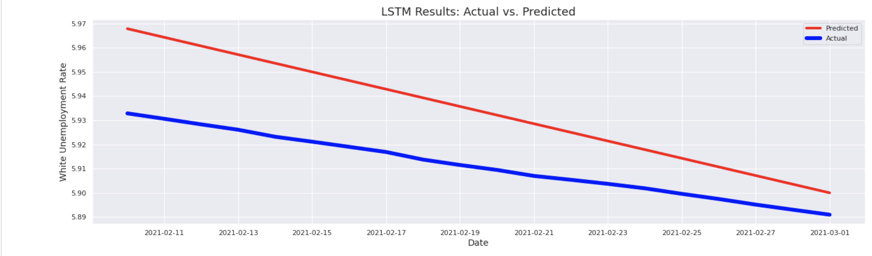
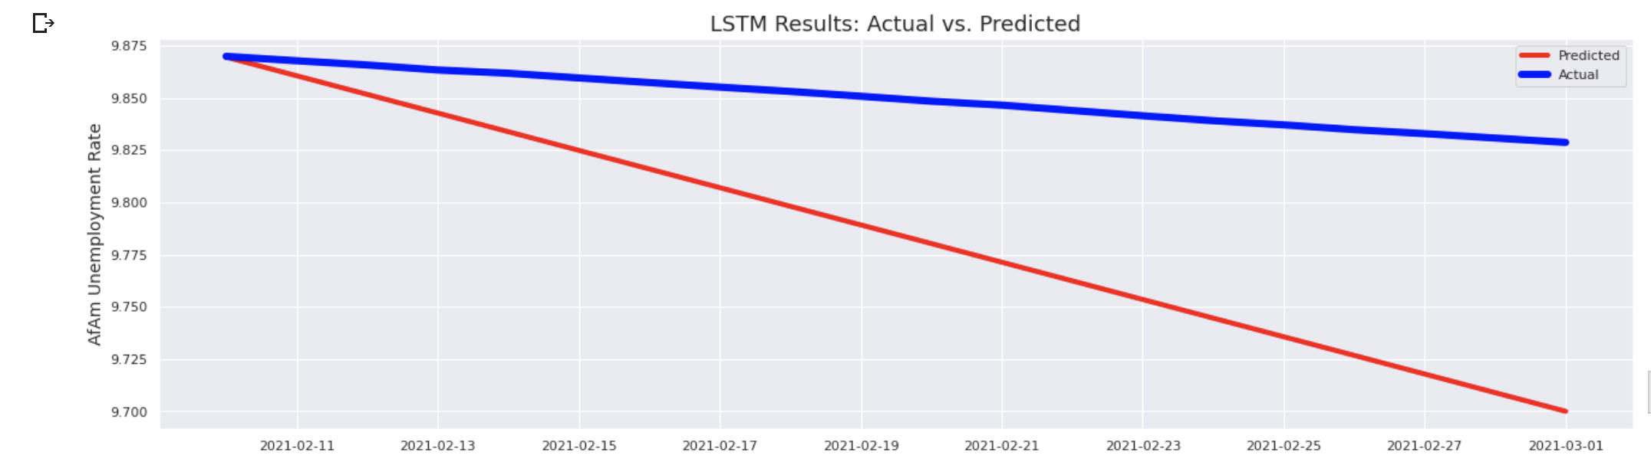
Long short-term memory (LSTM) Model - Unemployment

Slide 9
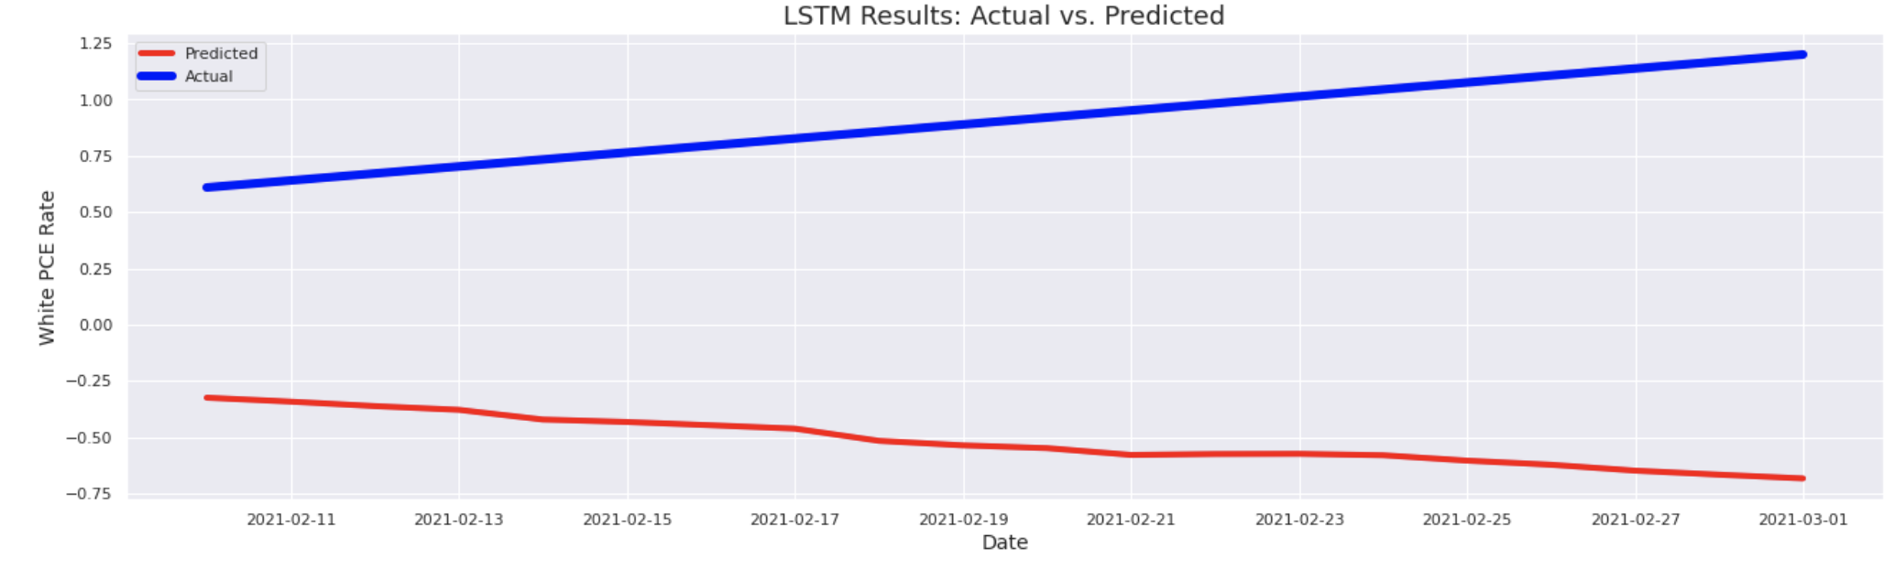
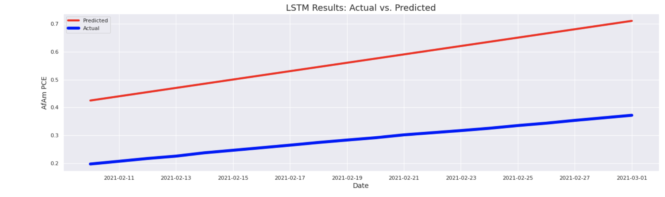
Long short-term memory (LSTM) Model - PCE

Slide 10
Long short-term memory (LSTM) Model
Small decline in unemployment and small increase in consumption for minority demographics. However, slightly greater changes compared to the previous model.
Small increase in unemployment and decrease in consumption for White and Asian groups. Slightly smaller gap when compared to the VAR Model.
Based on the Mean Absolute Percentage Error the level of accuracy was 94% for this model.
The results were consist with the prior model. Change in economic metrics but, not very significant. However, it had a much better accuracy rate

Slide 11
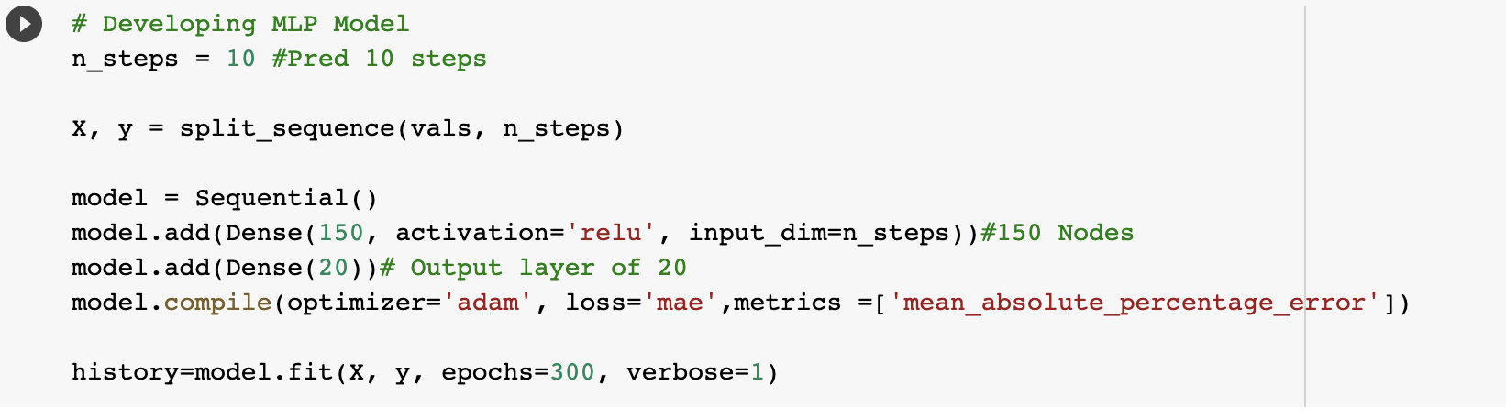
Multilayer Perceptron (MLP) Model
A MLP is a type of Artificial Neural Network uses a set of inputs to generate a set of outputs. It is defined by at least three layers. An input layer, hidden layer and output layer. The parameters can be seen below.

Slide 12
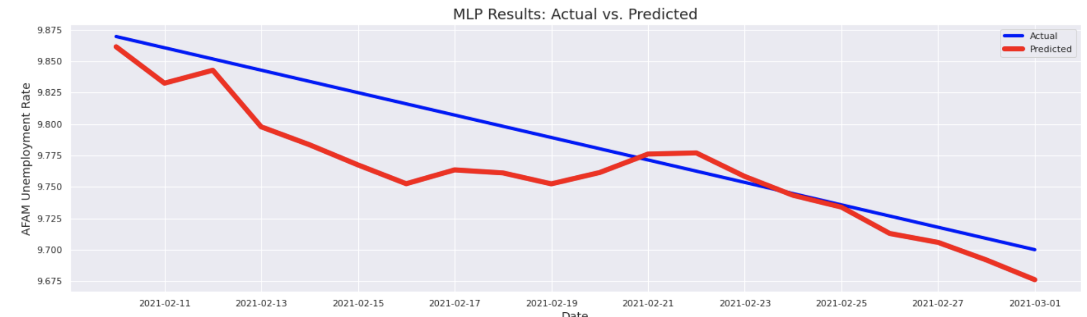
Multilayer Perceptron (MLP) Model

Slide 13
Multilayer Perceptron (MLP) Model
Small decline in unemployment for minority demographics. However, this model was inefficient to run.
The forecasted results did not follow a linear pattern which was inconsistent with the unemployment dataset. Ultimately, the forecasted results did not really make sense.
Compared to the previous models, the accuracy was about 84% and the errors were low.

Slide 14
Final Conclusions
The LSTM preformed the best. The MAPE value indicated an accuracy rate of 94%.I observed that the minority unemployment rate dropped slightly for minority demographics while, consumption increased. On the other hand, unemployment slightly increased and consumption decreased for Asian and White demographics.
Based on these models, higher vaccination rates for would lead to more money and more jobs for minority groups. While, the change was not as significant as I had hoped there was still some improvement. The forecasted unemployment rate dropped by 2.2% from the original value. The consumption rate increased by more than 45%
On the other hand, unemployment increased by about 1.3% and consumption decreased by nearly 40% for White and Asian demographics. The below plots illustrate the LSTM predictions from March 1st to July 1st. I will be able to confirm how well this model did when actual data is released soon!
I was able to confirm my hypothesis and vaccination rates can help fight economic inequality that exists between different races in MD.

Slide 15
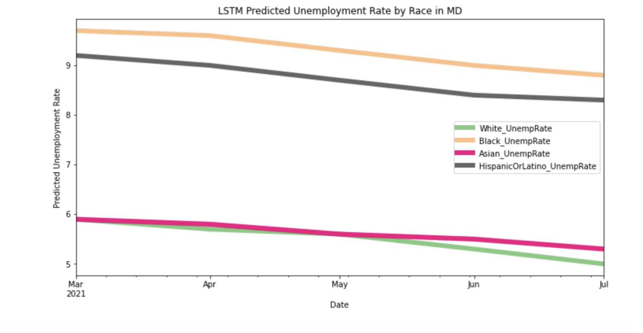
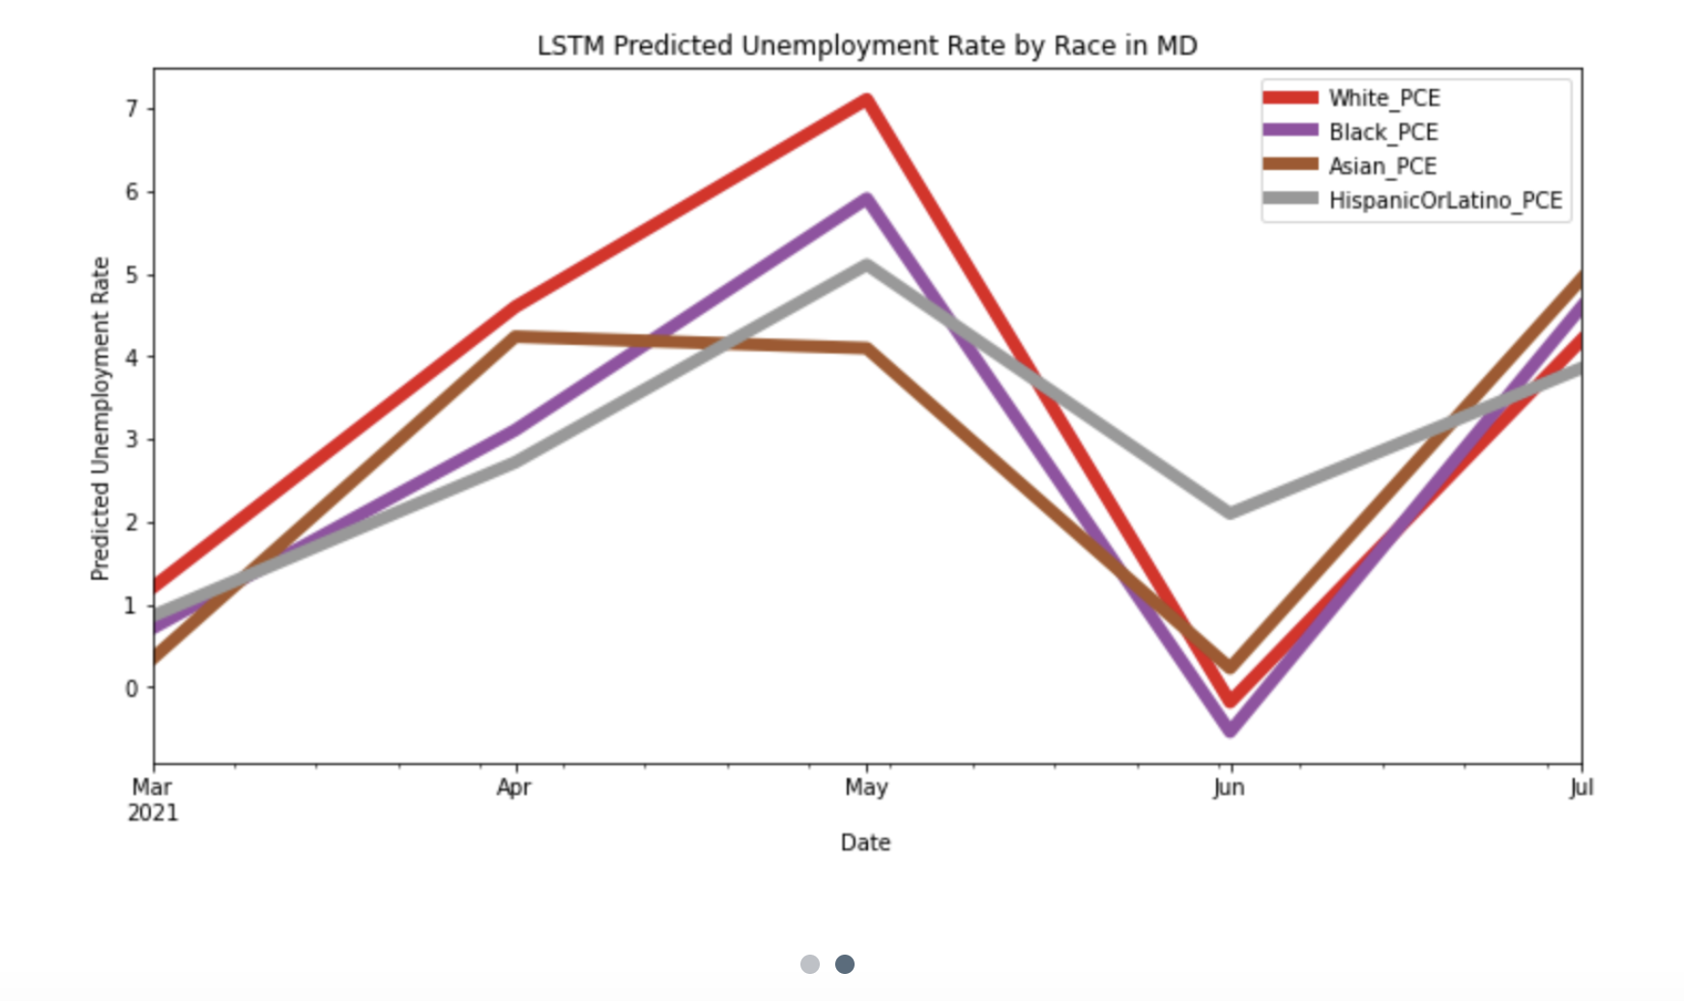
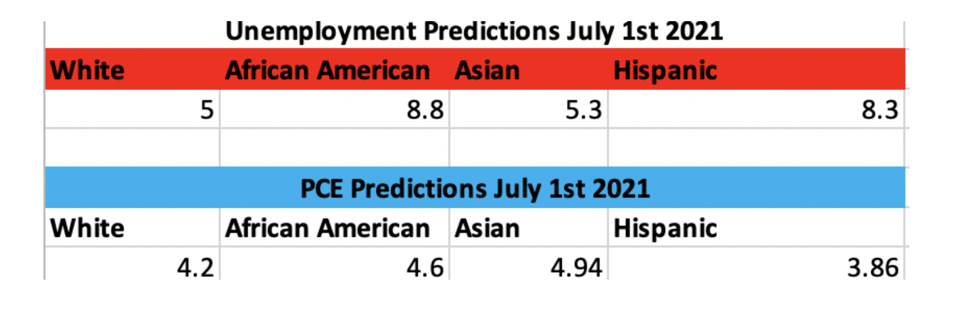
LSTM Predictions

Slide 16
Future Work
Hopefully this project will help others expand on these findings and conduct additional research. Possible future projects include the following:
Expand research to more demographics and metrics. Such as age, gender or income level.
Try additional machine learning methods.
Location of individuals or vaccination centers? See Travis Twigg's project "Determining Equitable COVID-19 Vaccination Site Locations Through Unsupervised Learning"

